Slide 1
Machine learning and deep learning model to predict loan defaults
By: Jóni Morgado Fortunato
Date: 6/12/2022

Slide 2
project
The data for this project was from the Kaggle competition, American Express - Default Prediction, the original data had 16 gb of training data as 30 gb of testing data, because of that the data was too big to open in a single data frame and it had to be fragmented in several csv.
The data is made of columns 190 consisting of theses variables:
customer_ID
Date
D_* = Delinquency variables
S_* = Spend variables
P_* = Payment variables
B_* = Balance variables
R_* = Risk variables
Target in binary, being 1 default
The date was monthly, and each customer could have 1 to 13 months of data, this will complicate things for prediction have to be made out of data with different size arrays.
To solve this I separated the csv by months, drop all columns with less then 75% of data and picked 1 to 7 month costumers, picking the last month of each entry, to train and test my models.

Slide 3
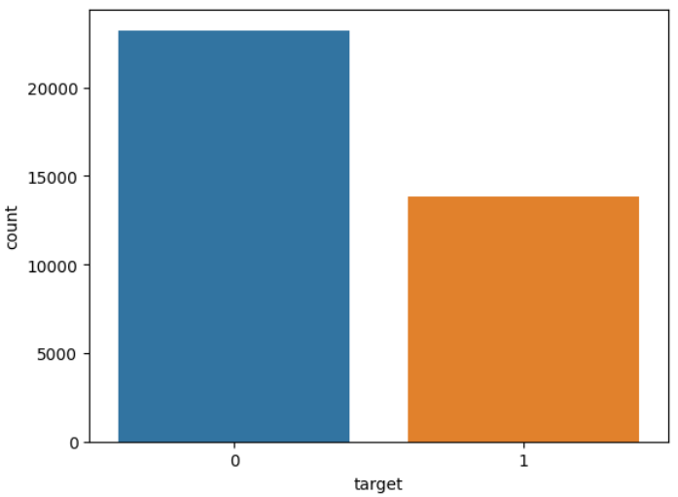
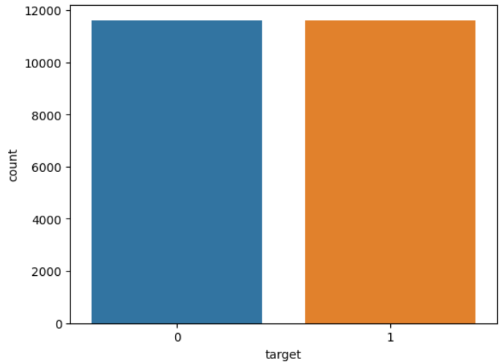
Original data
Sampling Data
To begin I look at the distribution of the target data, as we can see the target data does not have a equal distribution, so a sampling must use needed, to improve predictive power.
When sampling I reduce the data from 37053 observations to 23228 observations.
Sample data

Slide 4
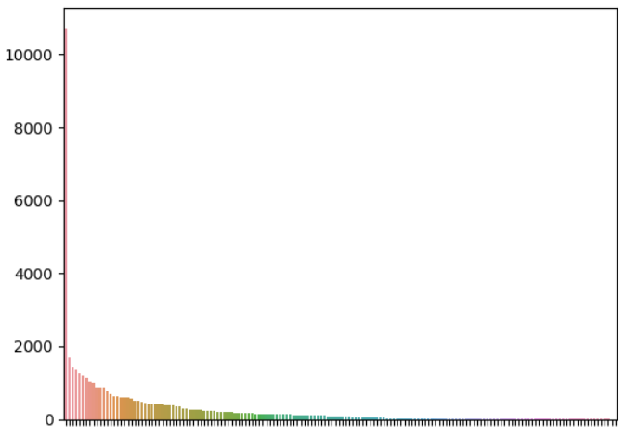
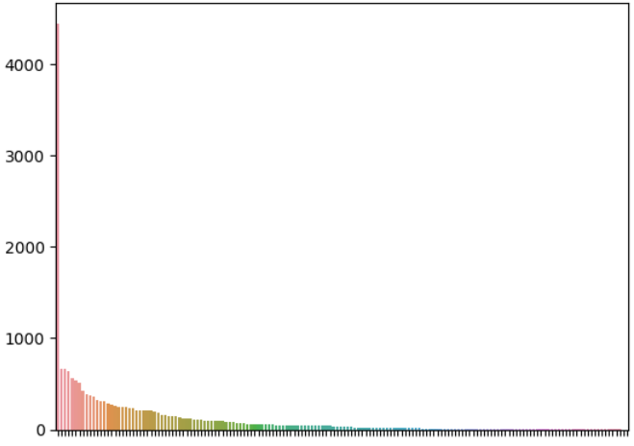
Selecting columns
Column importance in train Data
Because the columns with different months do not have the same proportion NaNs in the same columns, the 13 month data had different columns then the 1 to 7 month.
Because of that all columns had to be intercepted from both data samples. After that the 1 to 7 month data was broken in to the test and train samples.
After that the training data was place in a pipeline to input NaNs values, to encode categorical variables and scale values.
Now that I will check of the importance of each column.
As it can be seen there is a single column, S_5 spending column, that has an extremely high importance both in train and test.
This can be a blessing as this column alone can make it possible for a single decision tree to have a 83% accuracy rate in train. But….
Column importance in test Data

Slide 5
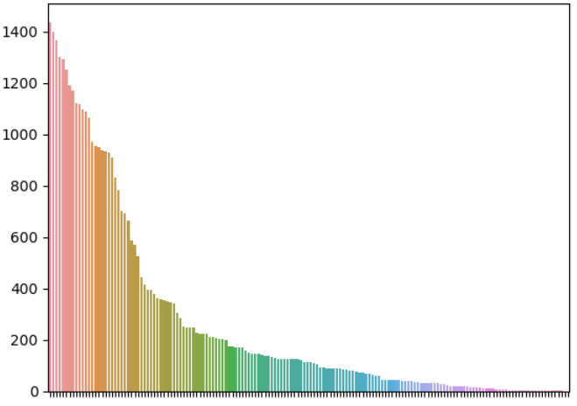
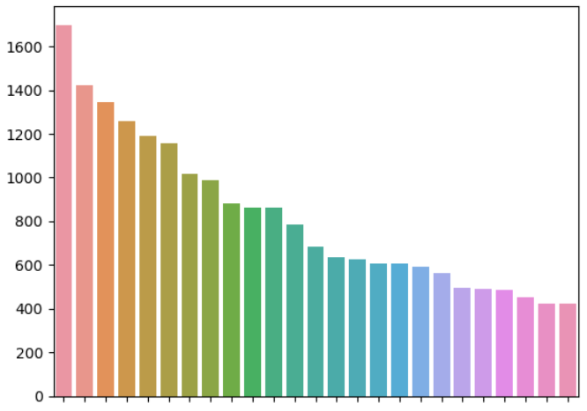
Selecting columns
Column importance in 13 month Data
Look at the last months of the 13 month data I see that there is no column with a big spick in importance.
Though in this project using this column could yell good results, there is possibility that this data being corrupt in that column.
Because of that the column is discarded, and the top 25 are selected.
Top 25 column importance in train Data

Slide 6
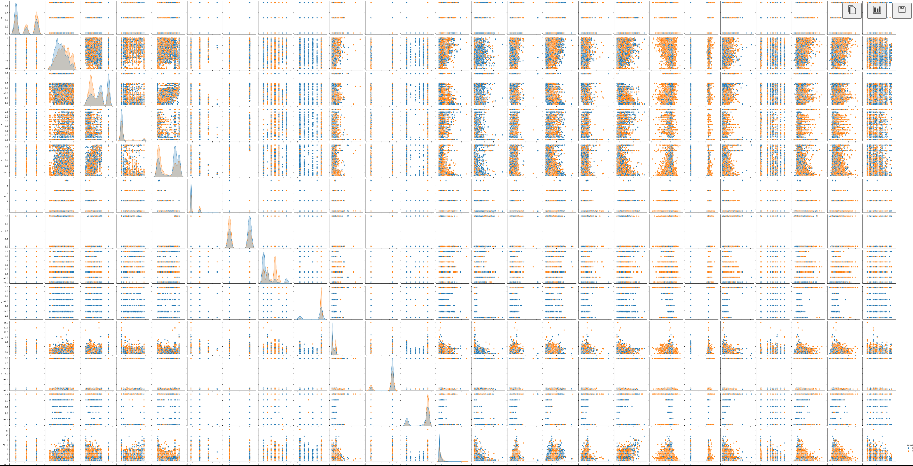
Pairplot selected columns

Slide 7
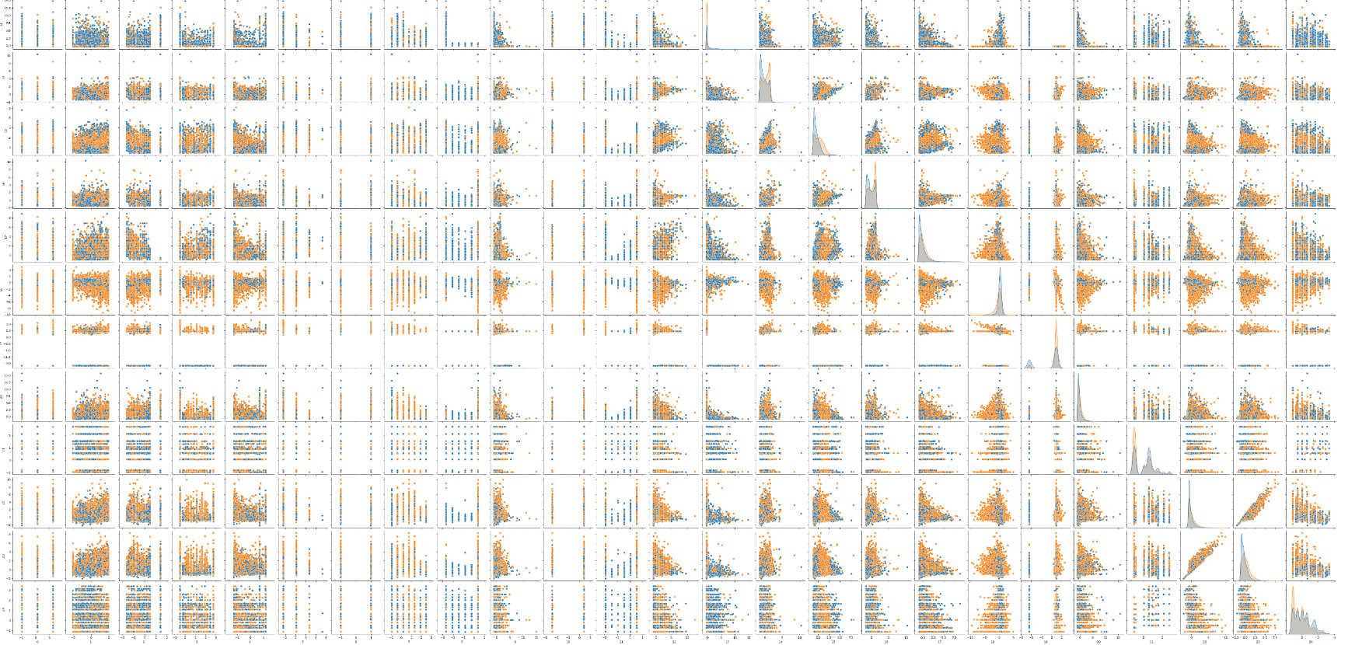
Pairplot selected columns

Slide 8
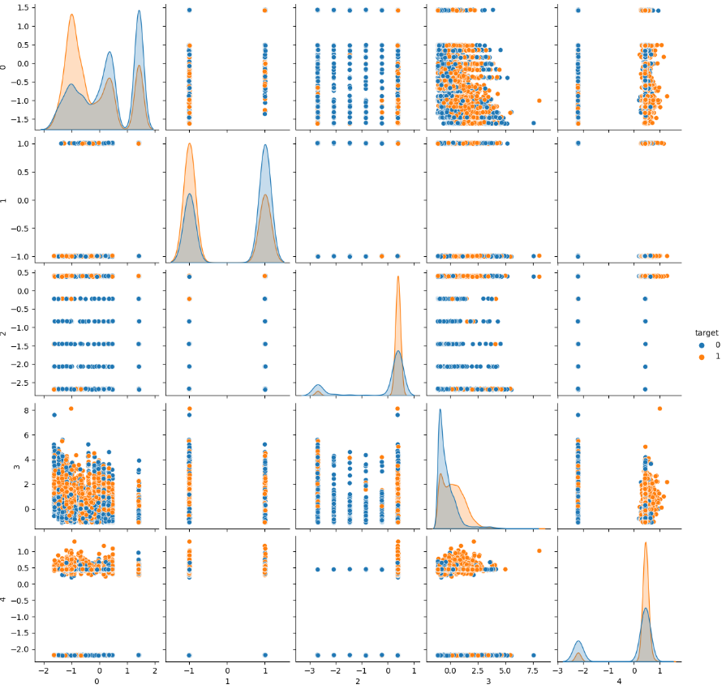
Pairplot selected columns

Slide 9
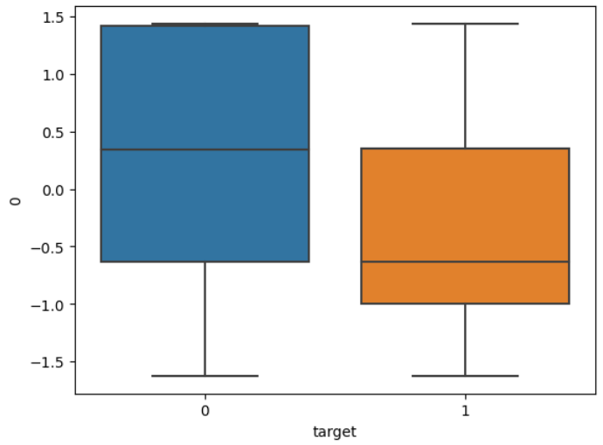
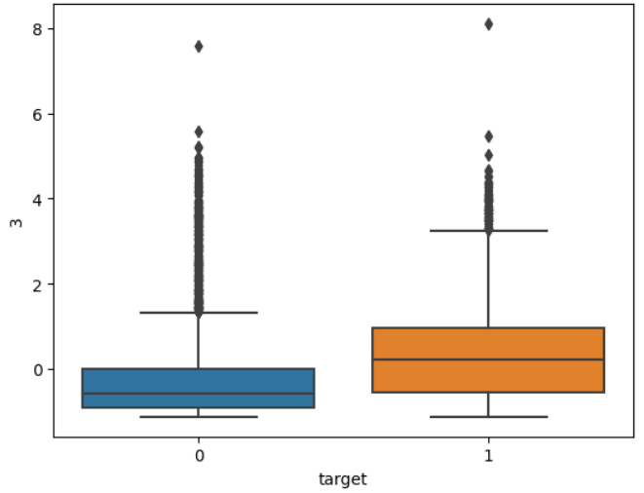
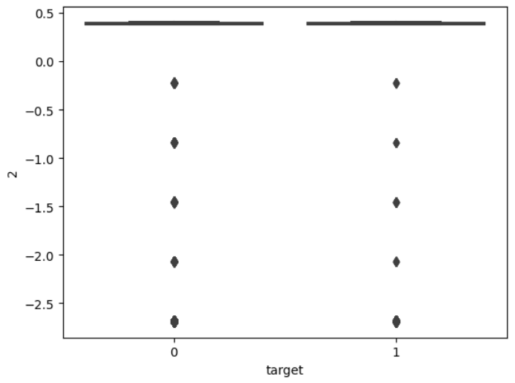
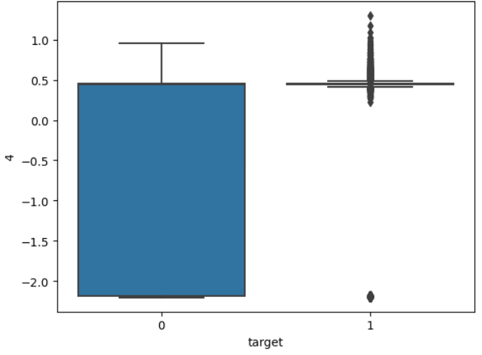
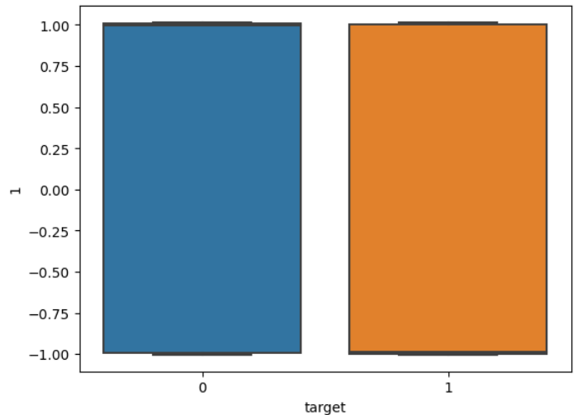
Top 5 columns

Slide 10
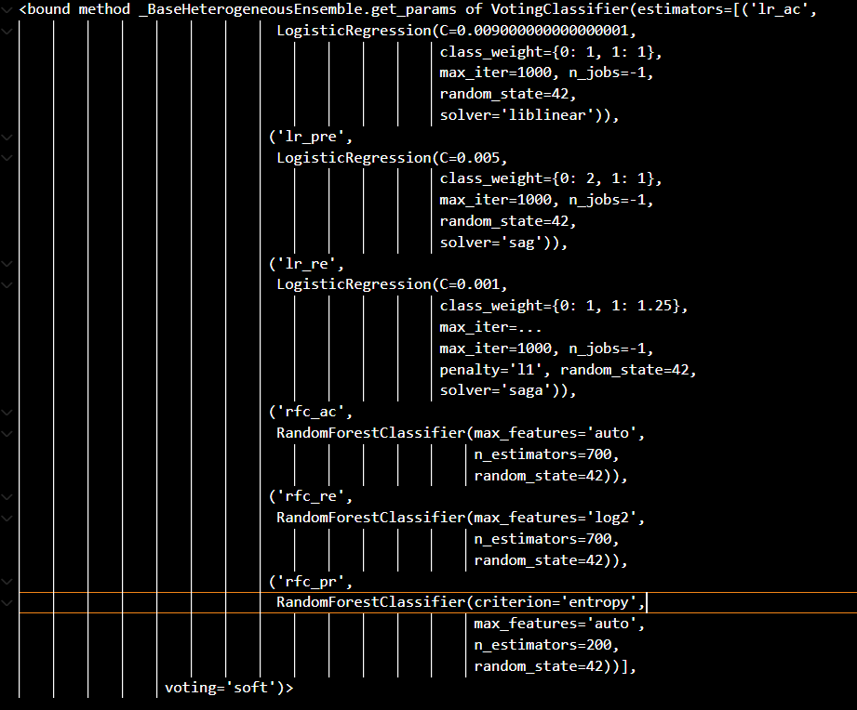
Models:
lr_ac: a logistic Regressor-
train for higher accuracy.
- lr_pre: a logistic Regressor- train for higher precision. - lr_re: a logistic Regressor- train for higher recall. - rfc_ac: Random Forest Classifier- train for higher accuracy. - rfc_re: Random Forest Classifier train for higher recall. - rfc_pr: Random Forest Classifier- train for higher precision.
Neuro network with 6 layers
“dictature” : Voting ensemble hard
“democracy”: Voting ensemble soft

Slide 11
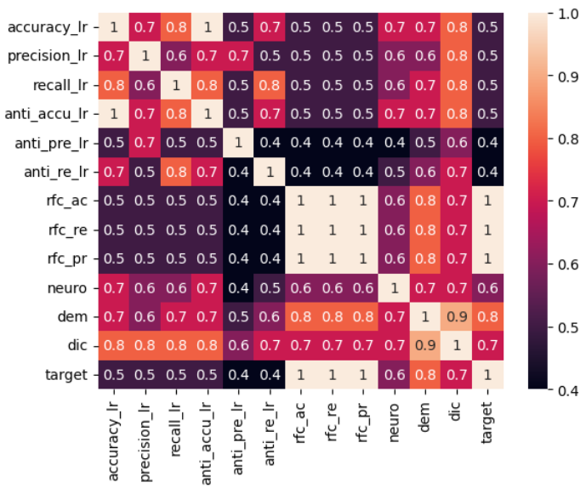
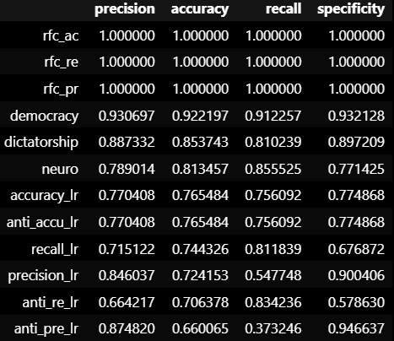
Scores in train
Here we see the correlation between the true target and each model prediction we can see the forest models have 1 in training this is due to overfitting the model.
The Second best score is the “democracy” model, soft voting, followed by “dictator”, hard voting, and
neuro-network
Here we see the different scores for each model

Slide 12
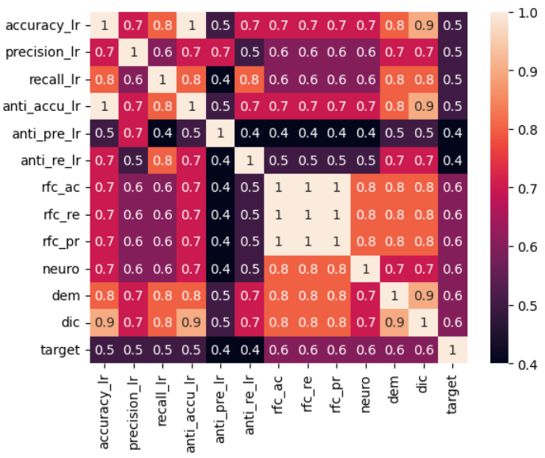
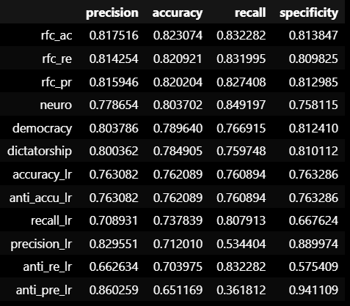
Scores in test
Here we see that the forest models were indeed overfitted as there value of correlation to the target drop from 1 to 0.6.
The voting models also had a reduction in correlation to the target, but the neuro-network maintained it’s correlation value, the logistic regressors also maintain there’s.
Here we see that the forests still command the lead but there drop in correlation and with the target and the accuracy score would recommend the neuro-network that seem more robust with unknown data.

Slide 13
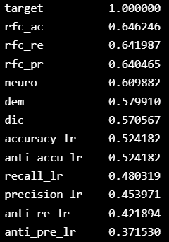



conclusion
Correlation from y_test to models predictions
For accuracy the accuracy fit forest had the best result with 82.3% .
However if recall is wanted one could use the neuro-network with a recall of 84.9%.
For precision the logistic Regressor trained with a reverse y for 86%.
And finally for specificity the logistic Regressor trained with a reverse y with a 94.1%
Personally I would say the best is the neuro-network due to its robustness.

Slide 14
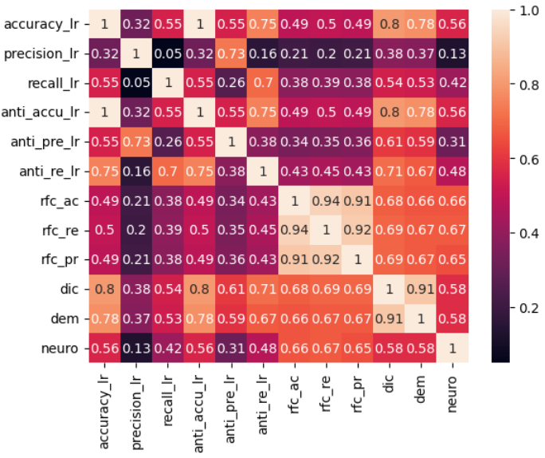
Correlation between model for correct predictions

